Slide 1
CENG 3005 Database Management Systems Week 8
Functional Dependencies
Normal Forms

Slide 2
OUTLINE
Database Management Systems Week 8
SQL
Ordering
Set Operations
Inner Join/Left Outer Join/Right Outer Join/Full Join
Aggregate Functions
Modifying the database (Delete/Insert/Update)
Views
Stored procedures
Functional Dependencies
Normal Forms

Slide 3
Today and next week we will learn:
What is normalization ? Why do we need it?
What does functional dependency mean? Why do we need it?
What role does it play in the database design process?
What do the normal forms 1NF, 2NF, 3NF, BCNF mean?
How normal forms can be transformed from lower normal forms to higher normal forms?
How some situations require denormalization to generate information efficiently?

Slide 4

Watch https://www.youtube.com/watch?v=UrYLYV7WSHM

Slide 5
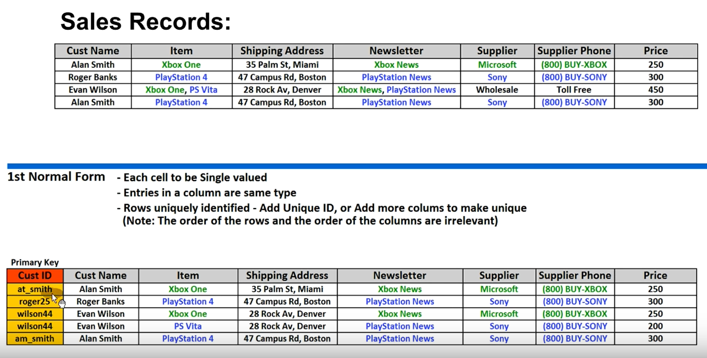

Slide 6
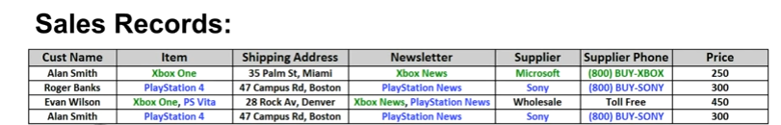
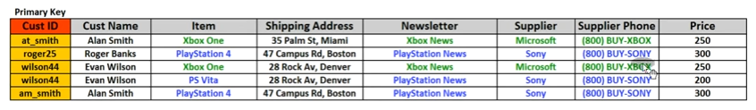
1NF

Slide 7
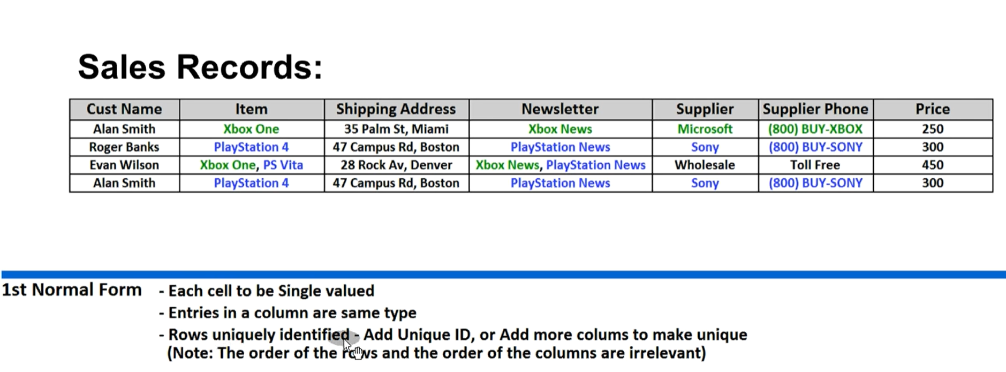
Watch https://www.youtube.com/watch?v=UrYLYV7WSHM

Slide 8
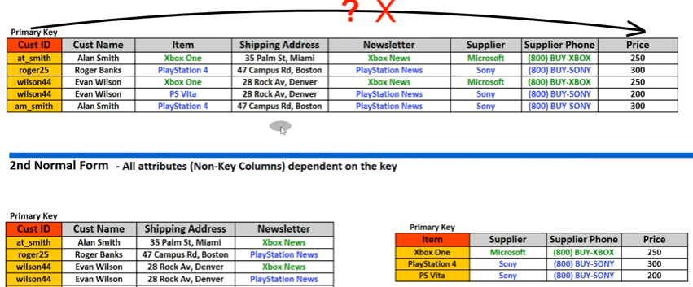
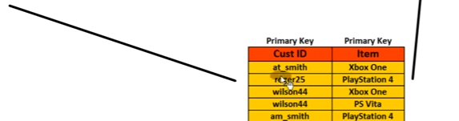
2NF

Slide 9
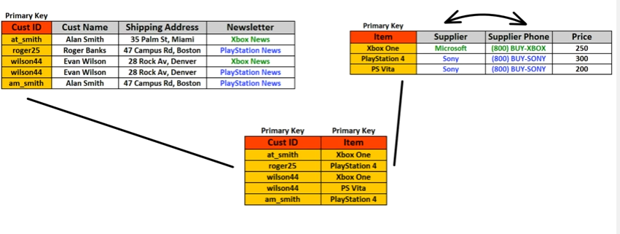
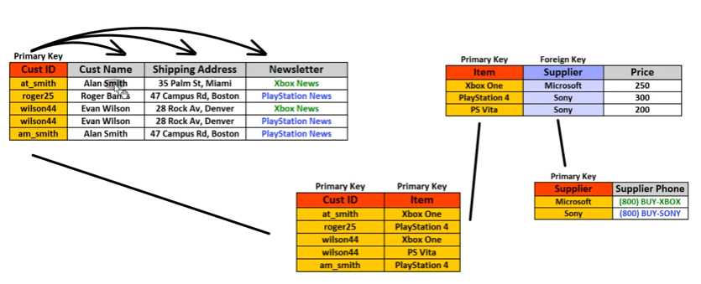
3NF

Slide 10

Functional Dependencies (FDs), and how to find Keys using them https://www.youtube.com/watch?v=i4sk4h2lhtU

Slide 11
Functional Dependencies (formal definition)
Definition: A functional dependency (FD) on a relation schema R is a constraint X -> Y, where X and Y are subsets of attributes/columns of R.
An FD X -> Y is satisfied in a row r of R if for every pair of tuples, t and s: if t and s agree on all attributes in X then they must agree on all attributes in Y
In other words, for a dependency to hold at a table R, if all the values on the left side attribute set (X) are same, they should be the same on the right side attribute set (Y)
If you know left side, you can assume you know right side!
SSN -> SSN, Name, Address

Slide 12
Functional Dependencies (Examples)
Address -> ZipCode
Stony Brook’s ZIP is 11733
ArtistName -> BirthYear
Picasso was born in 1881
Autobrand -> Manufacturer, Engine type
Pontiac is built by General Motors(Manufacturer) with gasoline engine (Engine Type)
Author, Title -> PublDate
Shakespeare’s Hamlet published in 1600

Slide 13
Entailment, Closure, Equivalence
Definition: If F is a set of FDs on schema R and f is another FD on R, then F entails f if every instance(row) r of R that satisfies every FD in F also satisfies f
Ex: F = {A -> B, B-> C} and f is A -> C
If Streetaddr -> Town and Town -> Zip then Streetaddr -> Zip
Definition: The closure of F, denoted F⁺, is the set of all FDs entailed by F
Definition: F and G are equivalent if F-> G and G-> F

Slide 14
Properties of Functional Dependencies
Reflexivity: If Y -> X then X -> Y (trivial FD)
Name, Address -> Name
Augmentation: If X -> Y then X Z-> YZ
If Town -> Zip then Town, Name -> Zip, Name
Transitivity: If X -> Y and Y -> Z then X -> Z

Slide 15
Derived inference rules
Union: if X-> Y and X-> Z, then X-> YZ.
Decomposition: if X-> YZ, then X-> Y and X-> Z.
Pseudotransitivity: if X-> Y and WY-> Z, then WX-> Z.

Slide 16
Generating F⁺
F (functional dependency list for your table)
AB-> C
AB-> BCD
A-> D AB-> BD AB-> BCDE AB-> CDE
D-> E BCD -> BCDE
union
decomp
aug
trans
aug
Thus, F⁺
consists of AB-> BD, AB -> BCD, AB -> BCDE,
and AB -> CDE

Slide 17
If you understood Functional Dependency so far, Normalization is so easy! Why do we need to normalize our databases?
We need a criterion for determining a table's degree of vulnerability to
1) logical inconsistencies and
2) anomalies.

Slide 18
Normalization of DB Tables
Normalization
Process for evaluating and correcting table structures
determines the optimal assignments of attributes to entities
Normalization provides micro view of entities
focuses on characteristics of specific entities
may yield additional entities
Works through a series of stages called normal forms
1NF -> 2NF -> 3NF -> 4NF (optional)
Higher the normal form, slower the database response
more joins are required to answer end-user queries
So if the response is slow, why do the database people normalize?
Reduce uncontrolled data redundancies
Help eliminate data anomalies
Produce controlled redundancies to link tables

Slide 19
Normalization Forms (simple simple simple)
“Data depends on the key [1NF]
the whole key [2NF]
and nothing but the key [3NF]”
“If all the arrows in FDs are out of a candidate key” [BCNF]

Slide 20
Normalization
is the process for evaluating and correcting table structures to minimize data redundancies
reduces data anomalies
works through a series of stages called normal forms
First normal form (1NF)
Second normal form (2NF)
Third normal form (3NF)
Edgar Codd, inventor of the Relational Model, introduced the normal forms in 1970s

Slide 21
Normalization Example
We have a table with name R1; containing orders in an online store
Each entry in the table represents an item on a particular order
Columns
Order
Product
Customer
Address
Quantity
UnitPrice
Primary key is {Order, Product}

Slide 22
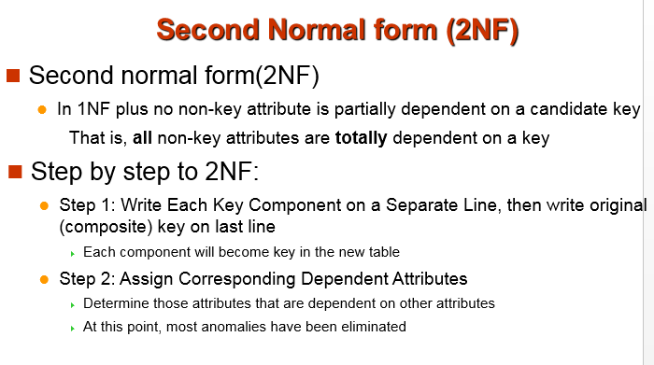

Slide 23
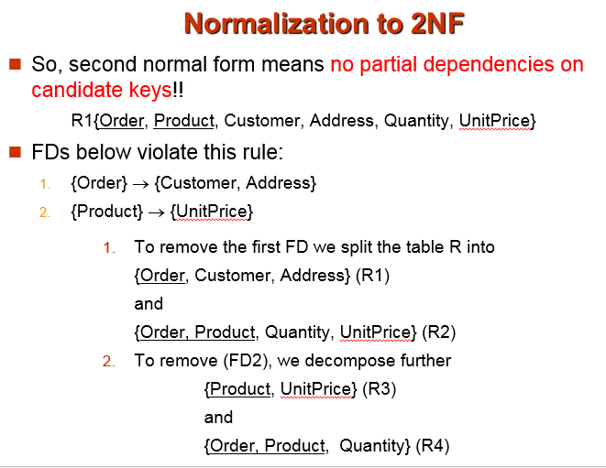

Slide 24
Functional Dependencies
All the Functional Dependencies for this table R1
{Order, Product, Customer, Address, Quantity, UnitPrice}
Each order is for a single customer
Each customer has a single address
Each product has a single price:
From FDs 1 and 2 and transitivity:
{Order}-> {Customer}
{Customer}-> -> {Address}
{Product} -> -> {UnitPrice}
{Order} -> {Address}
Contains partial dependency
Address depends only part of the primary key!!

Slide 25
Normalization to 3NF
R{Order, Product, Customer, Address, Quantity, UnitPrice} has now been split into 3 relations –
R1={Order, Customer, Address}
R3={Product, UnitPrice}
R4={Order, Product, Quantity}
R3 and R4 are in 3NF
BUT!!! R1 has a transitive FD on its key!!
To remove this transitive FD from R1
{Order} -> -> {Customer}-> -> {Address}
We decompose R1 over
{Order, Customer}
{Customer, Address}

Slide 26
Normalization
1NF:
{Order, Product, Customer, Address, Quantity, UnitPrice}
2NF (no partial dependency on key)
{Product, UnitPrice}
{Order, Product, Quantity}
{Order, Customer, Address}
3NF (no transitive dependence on a key)
{Product, UnitPrice}
{Order, Product, Quantity}
{Order, Customer}
{Customer, Address}

Slide 27
Another example: Course Schedules
Consider a relation, Schedule, which stores information about times for various schedules of courses
For example: labs for first years
Each course has several schedules
Only one schedule (of any course at all) takes place at any given time
Each student taking a course is assigned to a single schedule for it

Slide 28
FDs in the Course Schedule Relation
Candidate keys: {Student, Course} and {Student, Time}
Schedule has the following non-trivial FDs
{Student, Course} -> {Time}
{Time} -> {Course}
Since there is no partial dependency(2NF) and no transitive dependency(3NF), Schedule table is in 3NF

Slide 29
The Schedule Relation
Student Course Time
John Databases 12:00
Mary Databases 12:00
Richard Databases 15:00
Richard Programming 10:00
Mary Programming 10:00
RebeccaProgramming 13:00
Can you find the candidate keys?
Candidate keys: {Student, Course} and {Student, Time}

Slide 30
Anomalies in Schedule
INSERT anomalies
What if there is a new student with no class? You can’t add an empty schedule item (what if there is a new student with no class)
UPDATE anomalies
Moving the 12:00 class to 9:00 means changing two rows
DELETE anomalies
Deleting Rebecca removes one class(time/date) from schedule
Student Course Time
John Databases 12:00
Mary Databases 12:00
Richard Databases 15:00
Richard Programming 10:00
Mary Programming 10:00
Rebecca Programming 13:00

